Slide 1

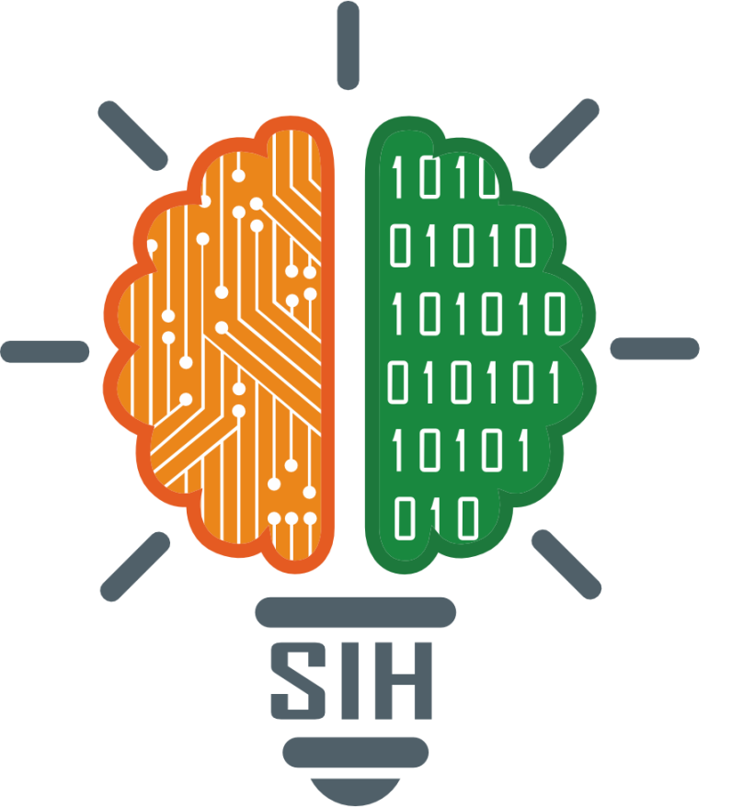
SMART INDIA HACKATHON 2025
CampusSathi: “ Your campus buddy in every language.”
Problem Statement ID – 25104
Problem Statement Title- Language agnostic chatbot
Theme- Smart Education
PS Category- Software
Team ID- 88302
Team Name - Encodr

Slide 2
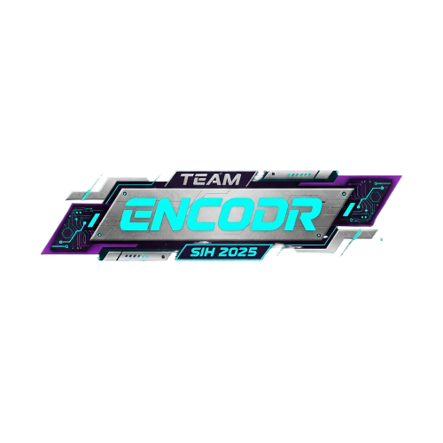
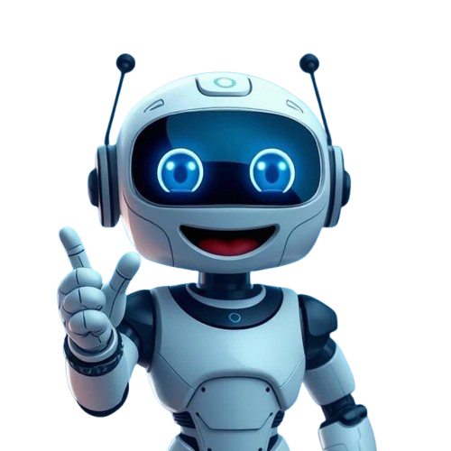


IDEA TITLE
A conversational AI assistant that ingests college circulars, FAQs, and PDFs, and responds to student queries in English, Hindi, and multiple regional languages. It can be accessed via the college website and popular messaging apps, supports multi-turn conversations, logs queries for improvement, and escalates to staff when needed.
1
Multilingual-First Design
PROBLEM-SOLUTION
Unlike most chatbots, it’s built to handle English, Hindi, and multiple regional languages from the start, ensuring no student feels left out due to language barriers.
2
Hybrid model
Queues & Repeated Questions
AI answers instantly, no need to visit offices.
Uses AI for quick, automated answers to FAQs, but seamlessly escalates complex or unique cases to staff, ensuring both efficiency and human support.
Limited Access & Language Barriers
24×7 info in English, Hindi & regional languages.
3
Cross-platform access
Students can reach the assistant not only on the college website but also via popular messaging apps (WhatsApp, Telegram, etc.), making it accessible anytime, anywhere.
Staff Overload
Routine queries automated, staff handle complex cases.
4
Continuous improvement
Every query is logged and analyzed; feedback helps the assistant learn and improve daily, ensuring responses remain accurate, consistent, and relevant.
Inconsistent/ Outdated Info
Centralized, updated, and accurate responses.

Slide 3
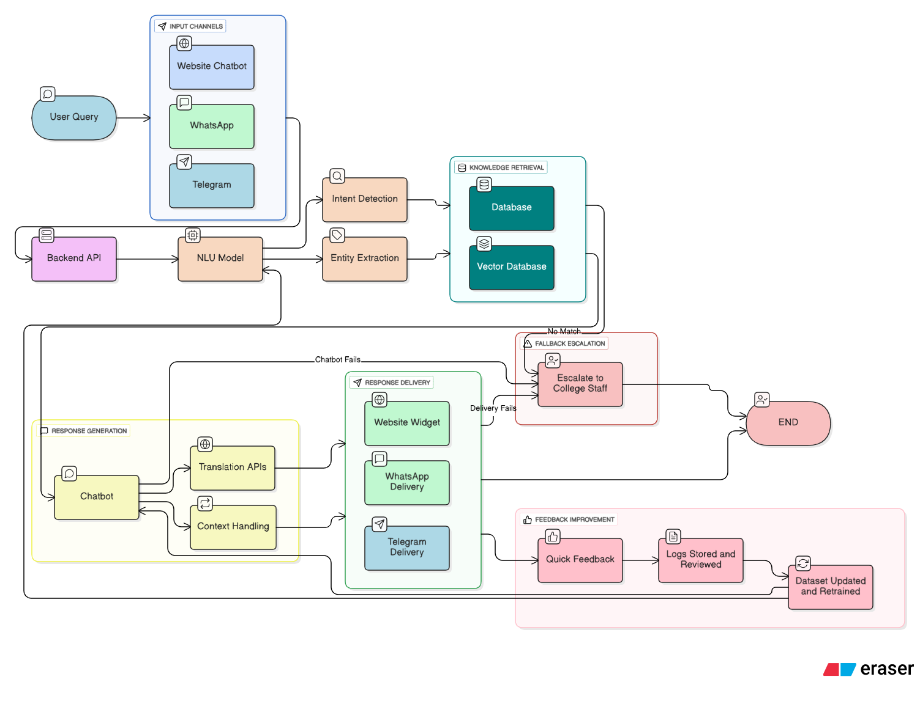
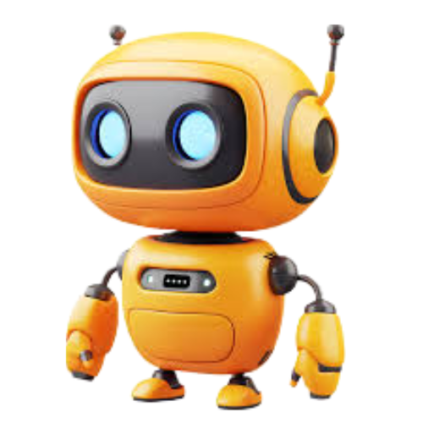
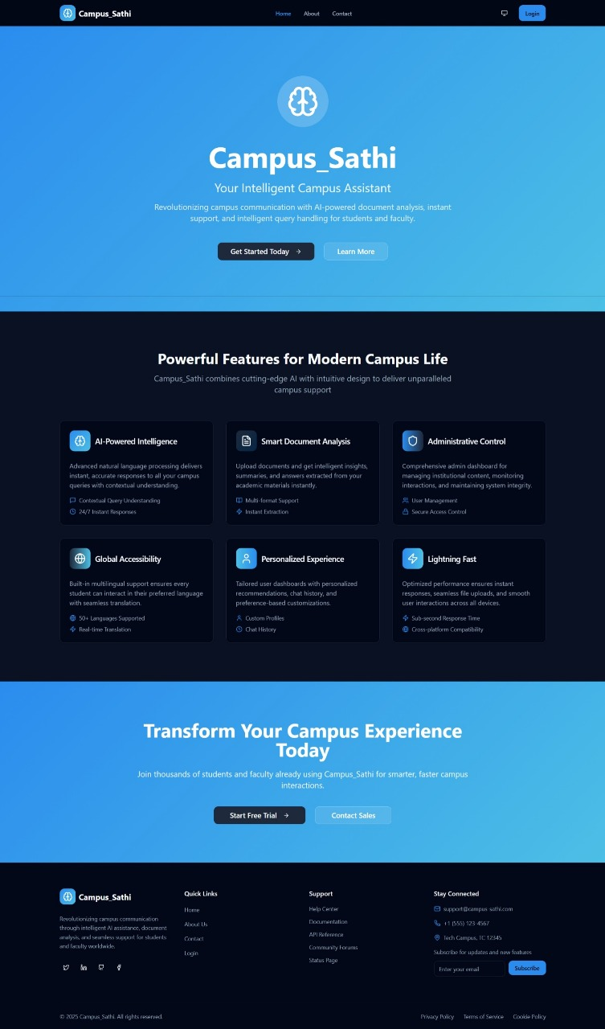
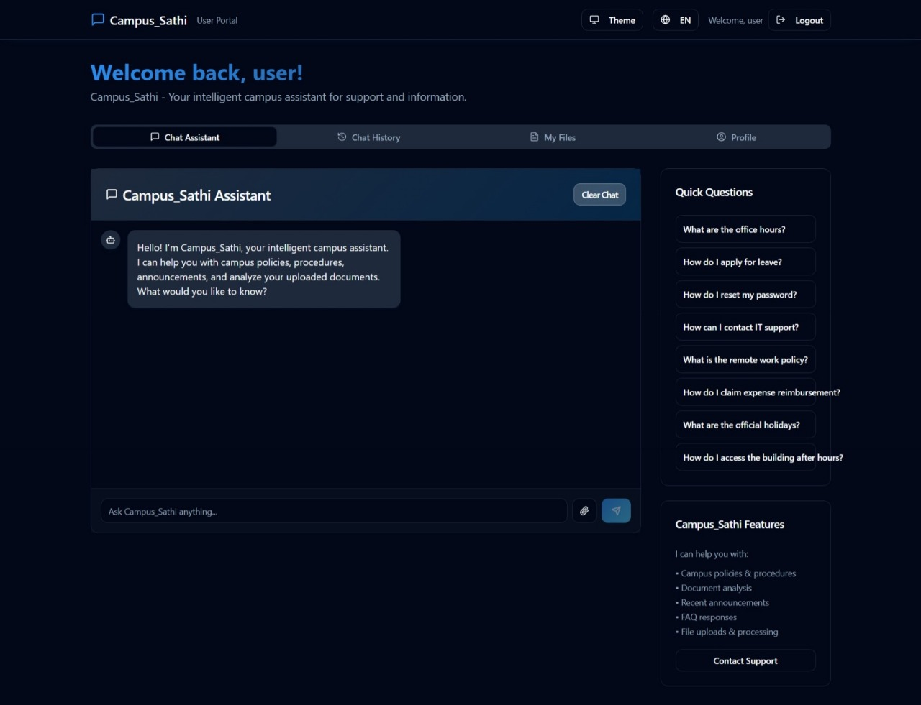
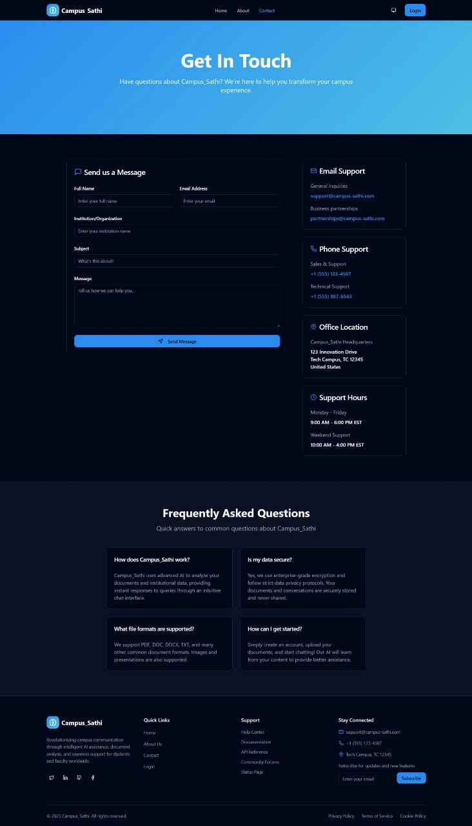
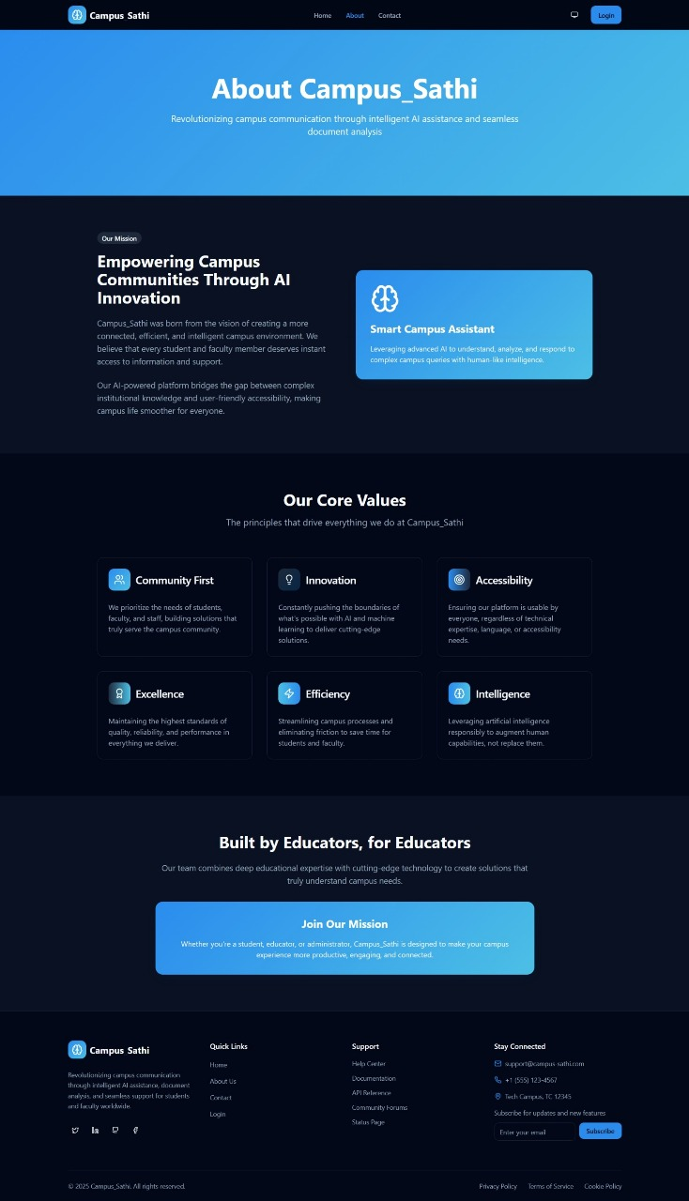
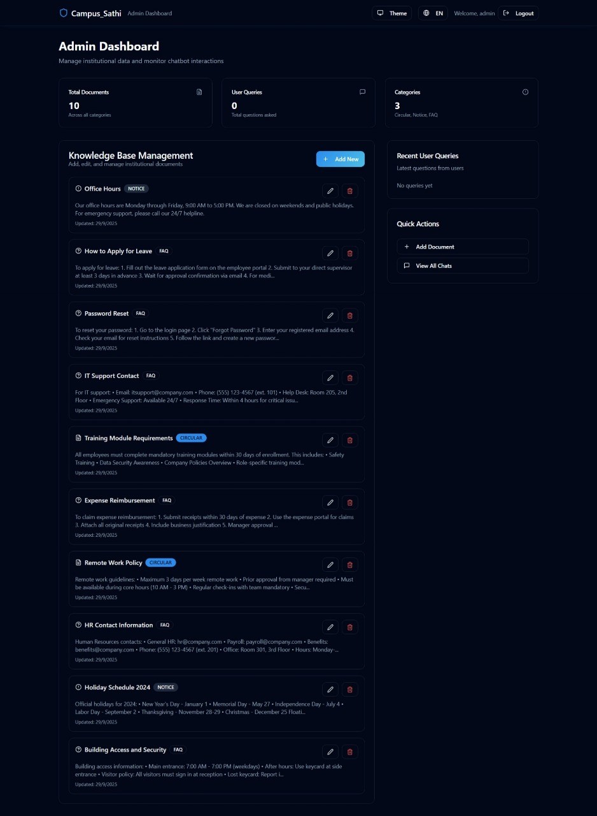
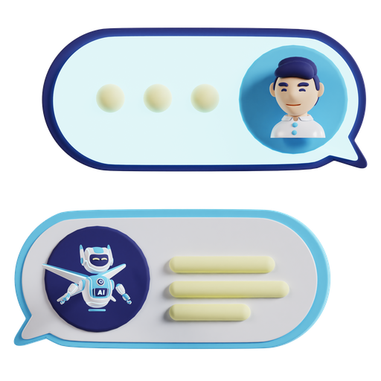
TECHNICAL APPROACH
Programming Languages:
Python / Node.js → Backend development
JavaScript → Frontend (React)
Frameworks & Tools:
Rasa / Dialogflow / LangChain → Chatbot logic & NLU
FastAPI / Express.js → API development
React: Web interface
Databases:
PostgreSQL / MongoDB → FAQs & logs
Vector DB (Pinecone / FAISS) → Semantic search
AI/ML Services:
Pre-trained multilingual NLP models (HuggingFace, Google Translation APIs)
Hosting Options:
Cloud (AWS / GCP / Azure)
On-college server for cost optimization
Prototype

Slide 4

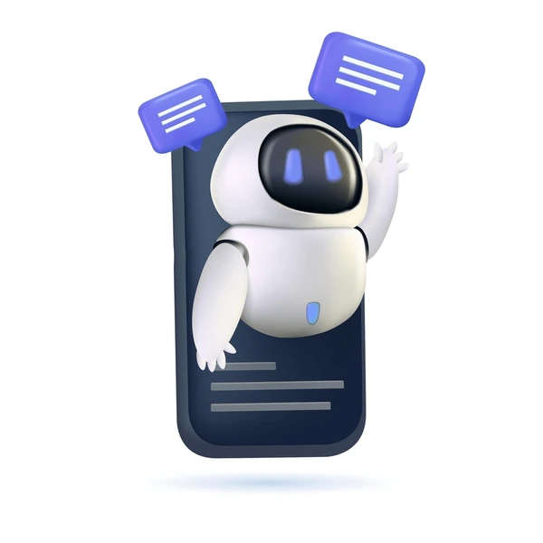
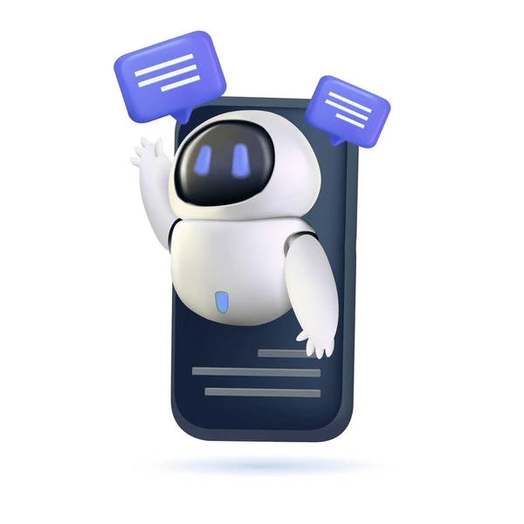




FEASIBILITY AND VIABILITY
Feasibility
Viability
Existing Technology Availability – NLP models (HuggingFace, Google Translate, Rasa) make multilingual chatbot development practical.
Low Cost of Infrastructure – Chatbots will work well with any standard web hosting and messaging APIs; they won't require any special hardware.
Hackathon Ready – Small knowledge base + MVP chatbot can be built in 2–3 days.
Cloud & Open-Source Support – Free-tier cloud services and open-source libraries reduce expenses.
Integration Ease – Embeddable on college website and connectable to WhatsApp/Telegram with minimal setup.
Scalability – Can easily add new FAQs, languages, and services over time.
Cost-Effective Operations – Saves staff hours, reduces paper use, and cuts administrative overhead.
Inclusive Access – Reaches all students regardless of language or digital literacy level.
Adoption Potential – Students are already comfortable with chat apps → faster acceptance.
Replicability – Solution can be adapted to other colleges/universities with minimal changes.
Challenges & Risk
Strategies
Language Accuracy – Regional dialects and slang may reduce response accuracy.
Context Handling – Multi-turn conversations may confuse the chatbot.
Data Privacy – Query logs may capture personal/sensitive information.
User Trust & Adoption – Students may not initially trust automated responses.
Maintenance Issues – Volunteer turnover could disrupt content updates.
Multilingual NLP + QA – Use pre-trained models with manual checks for accuracy.
Session Tracking – Maintain context across multi-turn conversations.
Data Privacy – Redact personal info and log only minimal details.
Human Fallback – Route unclear queries to staff for reliability.
Volunteer Dashboard – Simple tools and SOPs for easy FAQ updates.

Slide 5





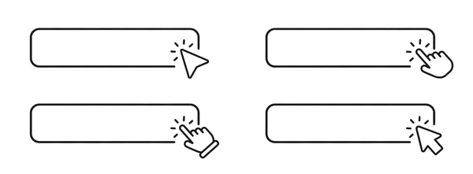


IMPACT & BENEFIT
Potential Impact
Benefits
24×7 Access
Social
Students receive instant answers anytime, in their preferred language.
Ensures equitable access to information for all students.
Reduced Wait Times
Economic
Shorter queues at offices; staff can dedicate time to complex tasks.
Saves administrative time → reduces operational overhead
Inclusive Learning
Environmental
Buisness Scope
Supports students more comfortable in Hindi or regional languages.
Cuts down paper usage by minimizing physical circulars and forms.
Cost Efficiency: Automates repetitive tasks, saving staff hours and reducing manpower needs.
High Adoption: 80%+ students prefer local languages, ensuring quick engagement.
Scalability: Easy to add FAQs, languages, and campuses; adaptable to other sectors.
Revenue Potential: One-time investment for multi-campus use; scalable SaaS model.
Brand Trust: Builds reputation through inclusive and timely information access.
Improved Awareness
Educational
Keeps students informed about deadlines, forms, timetables, and scholarships.
Encourages self-service, digital literacy, and greater autonomy among students.
Github Repo Link
Prototype Link

Slide 6




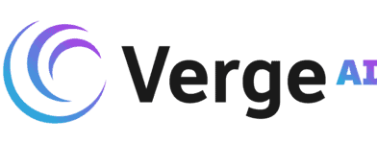




RESEARCH AND REFERENCES
ChatSense - A Multilingual Chatbot:
Feature | Others | CampusSathi
Domain-Specific Chatbot
AI-Driven Query Handling
Data Integration
Multilingual Support
Analytics & Insights
Ease of Use (Admin Panel)
This study presents the implementation of ChatSense, a multilingual AI assistant leveraging pre-trained language models such as Gemini-2.0-flash and Google Translate APIs. ChatSense
Dialogflow (Google Cloud)
Cloud-based NLU & intent recognition for text & voice bots, supports multi-language.
Georgia State University – Pounce Chatbot
University of Murcia – Lola Chatbot
University of Wisconsin–Green Bay – Phlash Chatbot
Deakin University – Genie Digital Assistant
BERT Paper – Devlin et al., 2019.
1
2
3
4
5

